Slide 1

Architecture of Computer Networks
Unit 1 INTRODUCTION
ZHOU Ling
School of Computer Science and Engineering
College of Software Engineering,
Southeast University, Nanjing
ling.zhou@seu.edu.cn

Slide 2



Tentative Lecture Grading Policy
Class attendance 5%
PPT homework + presentation 25%
Final exam (half-open book) 50%
Practice part 20%
Homework is due every Friday.
Lecture representative is responsible for collection.
The FORMAT of your PPT
file name hw1_张三.ppt
Hw1_张三.pptx

Slide 3





Grouping
4 supergroups
Each supergroup includes
20-21 students
10 mini groups
Each mini group: 2-3 students
A presentation: given by a mini group out of a supergroup each week
Four presentations each week
Notes:
Talk show脱口秀

Slide 4

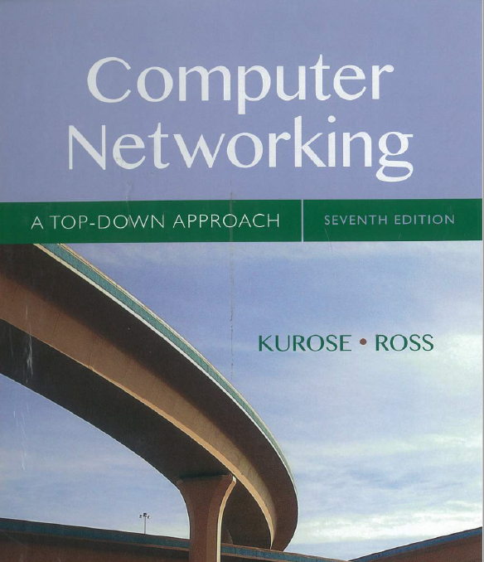
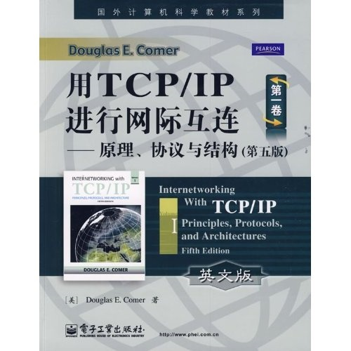
Reference textbooks
Textbook
Computer Networking: A Top-Down Approach , 7th edition. Jim Kurose, Keith Ross Hoboken, New Jersey: Pearson ©2017.
Internetworking With TCP/IP, Vol. I, Principles, Protocols, and Architectures 5th edition. Douglas E. Comer, Pearson Education, Aug. 2009.
计算机网络(第5版)
(谢希仁 编著)
电子工业出版社，2011年

Slide 5

Course Content
Unit 1 – Introduction
Unit 2 - IP Technology
Unit 3 - Network Switching
Unit 4 – Transport Layer
Unit 5 – Multimedia QoS
Unit 6 – Internal Routing
Unit 7 – External Routing
Unit 8 – Virtual Private Network
Unit 9 – Multicasting
Unit 10 – Wireless Mobile Network

Slide 6
Unit 1: Introduction
Our goal:
get “feel” and terminology
more depth, detail later in course
approach:
use Internet as example
Overview:
what’s a network?
what’s the Internet?
network edge: hosts, access net, physical media
network core: packet/circuit switching, Internet structure
performance: loss, delay, throughput
protocol layers, service models
security
history

Slide 7
Unit 1: roadmap
1.1 What is a network?
1.2 What is the Internet?
1.3 Network edge
end systems, access networks, links
1.4 Network core
circuit switching, packet switching, network structure
1.5 Delay, loss and throughput in packet-switched networks
1.6 Protocol layers, service models
1.7 Networks under attack: security
1.8 History

Slide 8
What is a network?
Q: What does a cloud represent?
Network
node
?
link
Internet
host
node
Interconnection network
(Network of networks)
Networks connect many nodes.
The Internet connects many networks.
Q: Except the Internet, any other kinds of networks?
Notes:
Nodes can be computer, router, switch, bridge …
In most cases, a cloud represents a network. In this way, users do not need to care about details in the network.
internet 和 Internet 的区别
以小写字母 i 开始的 internet（互联网或互连网）是一个通用名词，它泛指由多个计算机网络互连而成的网络。
以大写字母I开始的的 Internet（因特网）则是一个专用名词，它指当前全球最大的、开放的、由众多网络相互连接而成的特定计算机网络，它采用 TCP/IP 协议族作为通信的规则，且其前身是美国的 ARPANET。
网络是指“三网”，即电信网络、有线电视网络和计算机网络。The abbreviation CATV is often used to mean "Cable TV".
发展最快的并起到核心作用的是计算机网络。进入 20 世纪 90 年代以后，以因特网为代表的计算机网络得到了飞速的发展。
已从最初的教育科研网络逐步发展成为商业网络。
已成为仅次于全球电话网的世界第二大网络。
Telephone infrastructure, television company

Slide 9
Classification of Networks
Classification by Distance
1 m
10 m Room
100 m Building
1 km Campus
10 km Town
100 km Country
1000 km Continent
10000 km Planet
Personal Area Network (PAN)
Local Area Network (LAN)
Metropolitan Area Network (MAN)
Wide Area Network (WAN)
Internet
Notes:
Body area network: Monitoring a person in a pervasive electronic health care system
个人网（Personal Area Network，PAN）指个人范围（随身携带或数米之内）的计算设备（如计算机，电话，PDA，数码相机等）组成的通信网络。个人网即可用于这些设备之间互相交换数据，也可以用于连接到高层网络或互联网。
个人网可以是有线的形式，例如USB或者Firewire（IEEE1394）总线，也可以是无线的形式，例如红外（IrDA）或蓝牙。
蓝牙，是一种支持设备短距离通信（一般10m内）的无线电技术。能在包括移动电话、PDA、无线耳机、笔记本电脑、相关外设等众多设备之间进行无线信息交换。
利用“蓝牙”技术，能够有效地简化移动通信终端设备之间的通信，也能够成功地简化设备与因特网Internet之间的通信，从而数据传输变得更加迅速高效，为无线通信拓宽道路。
蓝牙采用分散式网络结构以及快跳频和短包技术，支持点对点及点对多点通信，工作在全球通用的2.4GHz ISM（即工业、科学、医学）频段。其数据速率为1Mbps。采用时分双工传输方案实现全双工传输。
Body-area network

Slide 10
Unit 1: roadmap
1.1 What is a network?
1.2 What is the Internet?
1.3 Network edge
end systems, access networks, links
1.4 Network core
circuit switching, packet switching, network structure
1.5 Delay, loss and throughput in packet-switched networks
1.6 Protocol layers, service models
1.7 Networks under attack: security
1.8 History

Slide 11
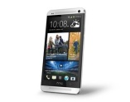


What’s the Internet: “nuts and bolts” view
PC
millions of connected computing devices: hosts = end systems
running network apps
Mobile network
server
Global ISP
wireless
laptop
cellular
handheld
smartphone
Home network
communication links
fiber, copper, radio, satellite
transmission rate = bandwidth
Regional ISP
access
points
Enterprise network
wired
links
Packet switches (routers + link-layer switches): forward packets (chunks of data)
router
Notes:
nuts and bolts
n.
具体细节
. a clamshell phone 翻盖式手机

Slide 12


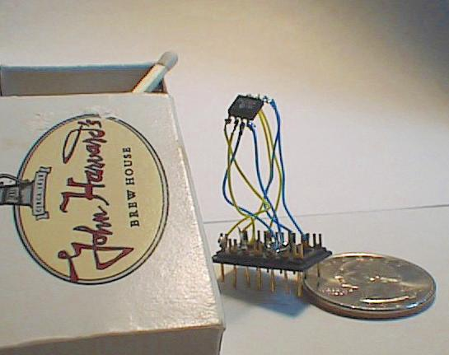

“Cool” internet appliances
Web-enabled toaster +
weather forecaster
IP picture frame
http://www.ceiva.com/
World’s smallest web server
http://www-ccs.cs.umass.edu/~shri/iPic.html
Internet phones
Notes:
matchbox

Slide 13
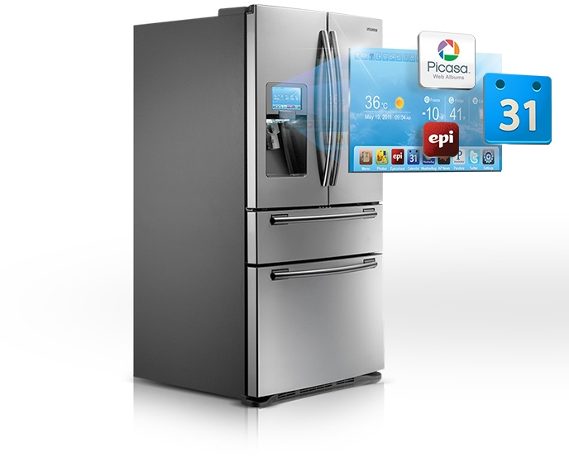
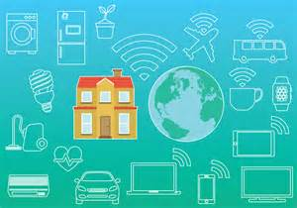

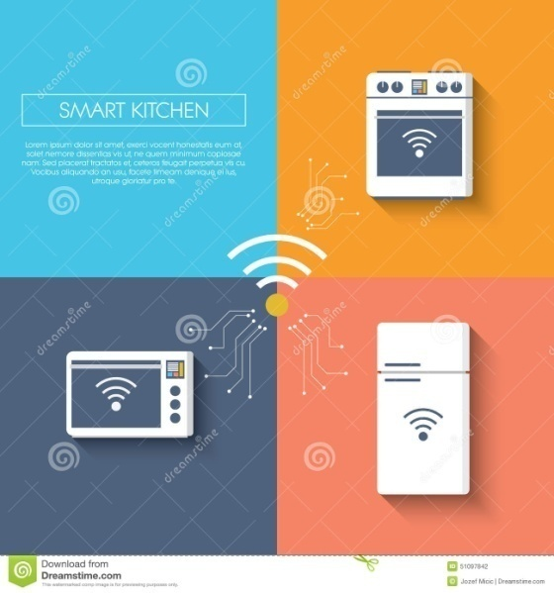

“Cool” internet appliances

Slide 14
What’s the Internet: “nuts and bolts” view
protocols control sending, receiving of msgs
e.g., TCP, IP, HTTP, Skype, Ethernet
Internet: “network of networks”
loosely hierarchical
public Internet versus private intranet
Internet standards
RFC: Request for comments
IETF: Internet Engineering Task Force
Mobile network
Global ISP
Home network
Regional ISP
Enterprise network

Slide 15
What’s the Internet: a service view
communication infrastructure enables distributed applications:
Web, VoIP, email, games, e-commerce, file sharing
communication services provided to apps:
reliable data delivery from source to destination
“best effort” (unreliable) data delivery (best effort service is a euphemism for no service at all)
Notes:
euphemism 搜索网络
英 [ˈju:fəmɪzəm] 美 [ˈjufəˌmɪzəm]
GRE
n. 委婉语; 委婉说法;
变形 复数: euphemisms
A network that delivered no packets to the destination would satisfy the definition of best-effort deliver service.

Slide 16
What’s a protocol?
human protocols:
“what’s the time?”
“I have a question”
introductions
… specific msgs sent
… specific actions taken when msgs received, or other events
network protocols:
machines rather than humans
all communication activity in Internet governed by protocols
protocols define format, order of msgs sent and received among network entities, and actions taken on msg transmission & receipt
Notes:
Nontraditional Internet end systems such as TVs, laptops, gaming consoles, cell phones, Web cams, automobiles, environmental sensing devices,
picture frames, and home electrical and security systems are being connected to the Internet. Indeed, the term computer network is beginning to sound a bit dated, given the many nontraditional devices that are being hooked up to the Internet. In Internet jargon, all of these devices are called hosts or end systems.
A desktop IP-capable picture frame [Ceiva 2009] downloads digital photos from a remote server and displays them in a device that looks like a traditional picture frame;
An Internet toaster downloads meteorological information from a server and burns an image of the day's forecast (e.g., mixed clouds and sun) on your morning toast.

Slide 17


What’s a protocol?
a human protocol and a computer network protocol:
Hi
TCP connection
request
Hi
TCP connection
response
Got the
time?
Get http://www.seu.edu.cn
2:00
<file>
time
Q: Other human communication protocols?

Slide 18




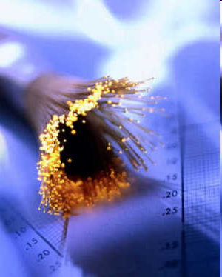
Examples: Optical Communications
Smoke signals
Traffic lights
Naval signals (ship flags)
Landing lights for aircrafts
…

Slide 19





Top Level View of the Organization of Internet Standards
Internet Engineering Steering Group
IETF Administrative Oversight Committee
IAOC
IESG
Internet Architecture Board
IETF Administrative Support Activity
RFC
Editor
IASA
Areas
Internet Research Task Force
Internet Assigned Numbers Authority
IAD
Internet Engineering Task Force
IETF Area Directors
Notes:
The Internet Research Task Force (IRTF) focuses on longer term research issues related to the Internet while the parallel organization, the Internet Engineering Task Force (IETF), focuses on the shorter term issues of engineering and standards making.

Slide 20
Internet Architectural Management
Internet Architecture Board
Internet Engineering Task Force
Internet Research Task Force
IESG
IRSG
Internet Engineering Steering Group
Internet Research Steering Group

Slide 21
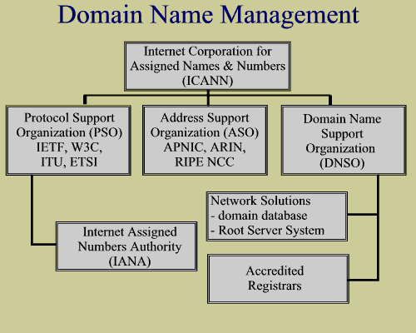
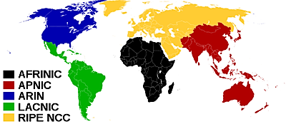
Domain Name Management
ICANN generally sets up the system but delegates all of the work to IANA
IANA
operates at the highest international level of organization
but divides the work up further among the five Regional Internet Registry's.
These five organizations give out blocks of numbers to ISP's.

Slide 22
IETF and non-IETF Submission
Workding group doc, or individual standards track doc
Individual
Content concerns and editorial details
Submit
Concerns
Submit
IESG
RFC Editor
RFC Editor
IESG
Comments
Comments, suggestions
Published RFC
Last Call
Publish
IETF Community
Review
IETF submission
Non-IETF submission

Slide 23
IETF Documents – Two Types
All IETF documents are open, i.e., anyone can download and copy
Internet Draft (ID) | Request For Comment (RFC)
Active working documents Not finalized! Not stable! Anyone can submit e.g., draft-yourname-... Only some IDs are WG documents! e.g., draft-ietf-wgname-... | Archival publications Never change once published Not all RFCs are standards! Standards track: Proposed Standard Draft Standard Internet Standard Other types: Informational Experimental Historical Best-Current-Practice (BCP)

Slide 24
Unit 1: roadmap
1.1 What is a network?
1.2 What is the Internet?
1.3 Network edge
end systems, access networks, links
1.4 Network core
circuit switching, packet switching, network structure
1.5 Delay, loss and throughput in packet-switched networks
1.6 Protocol layers, service models
1.7 Networks under attack: security
1.8 History

Slide 25
A closer look at network structure:
network edge: applications and hosts (devices at the edge)
access networks, physical media: wired, wireless communication links
network core:
interconnected routers
network of networks
Notes:
Host = end system

Slide 26
The network edge:
end systems (hosts):
run application programs
e.g. Web, email
at “edge of network”
peer-peer
client/server model
client host requests, receives service from always-on server
e.g. Web browser/server; email client/server
client/server
peer-peer model:
minimal (or no) use of dedicated servers
e.g. Skype, BitTorrent
Notes:
increasingly, many applications are peer-to-peer (P2P)
applications, in which end systems interact and run programs that perform both
client and server functions. For example, in P2P file-sharing applications (such as
BitTorrent and eMule), the program in the user's end system acts as a client when it
requests a file from another peer; and the program acts as a server when it sends a
file to another peer.

Slide 27
Access networks and physical media
Q: How to connect end systems to edge router?
residential access nets
institutional access networks (school, company)
mobile access networks
Keep in mind:
bandwidth (bits per second) of access network?
shared or dedicated?

Slide 28
Digital Subscriber Line (DSL)
Existing phone line:
0-4KHz phone;
4-50KHz upstream data; 50KHz-1MHz downstream data
Internet
DSLAM :
DSL Access Modem
home
phone
splitter
DSLAM
telephone
network
DSL
modem
central
office
home
PC
Uses existing telephone infrastructure
up to 1 Mbps upstream (today typically < 256 kbps)
up to 8 Mbps downstream (today typically < 1 Mbps)
dedicated physical line to telephone central office

Slide 29
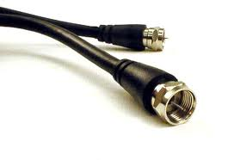
Residential access: cable modems (1)
Does not use telephone infrastructure
Instead uses cable TV infrastructure
HFC: hybrid fiber coax
both fiber and coaxial cable are employed in this system
asymmetric: up to 30Mbps downstream, 2 Mbps upstream
network of cable and fiber attaches homes to ISP router
homes share access to router
unlike DSL, which has dedicated access

Slide 30
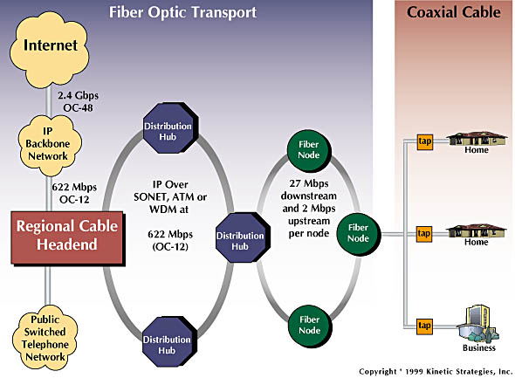
Residential access: cable modems (2)
Diagram: http://www.cabledatacomnews.com/cmic/diagram.html

Slide 31

Cable Network Architecture: Overview
Typically 500 to 5,000 homes
cable headend
cable distribution
network (simplified)
home

Slide 32
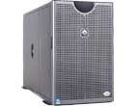
Cable Network Architecture: Overview
server(s)
cable headend
cable distribution
network
home

Slide 33
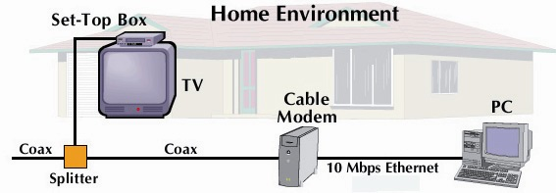
Cable Network Architecture: Overview
cable headend
cable distribution
network (simplified)
home

Slide 34
Cable Network Architecture: Overview
frequency-division multiplexing (FDM):
C
O
N
T
R
O
L
V
I
D
E
O
V
I
D
E
O
V
I
D
E
O
V
I
D
E
O
V
I
D
E
O
V
I
D
E
O
D
A
T
A
D
A
T
A
1
2
3
4
5
6
7
8
9
Channels
cable headend
cable distribution
network
home

Slide 35
Fiber to the Home
Optical Line Terminator (OLT)
Optical Network Terminator (ONT)
ONT
Internet
optical fibers
optical fiber
ONT
OLT
optical
splitter
central office
ONT
Optical links from central office to the home
Two competing optical technologies:
Passive Optical network (PON)
Active Optical Network (AON)
Much higher Internet rates; fiber also carries television and phone services

Slide 36
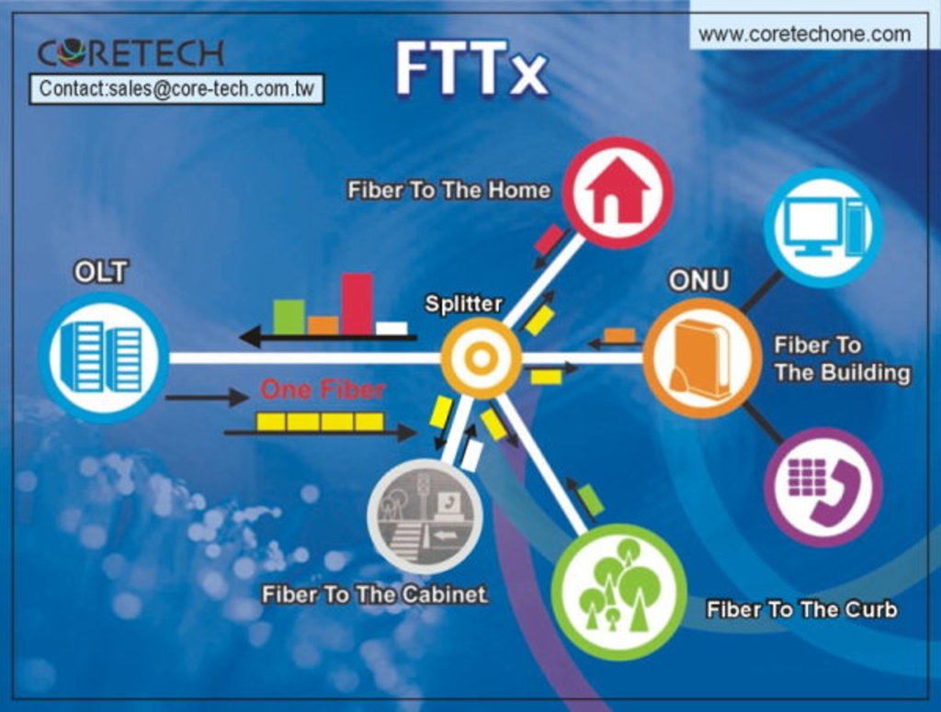

Slide 37
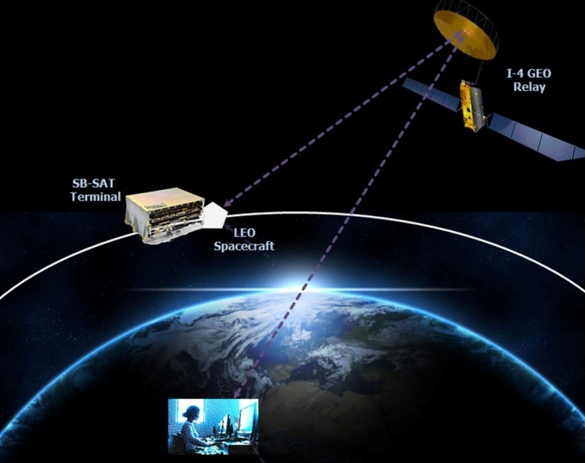
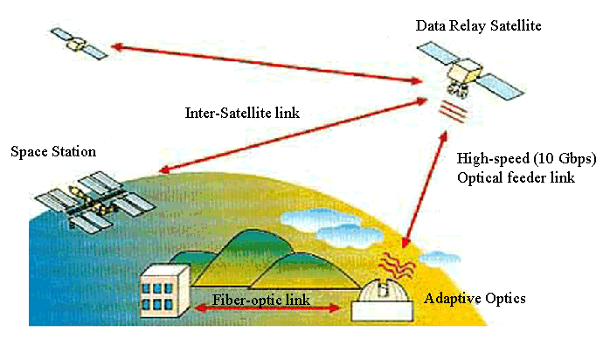
Satellite
A satellite link can be used to connect a residence to the Internet at speeds of more than 1Mbps (downstream ~ 50Mbps).
StarBand and HughesNet are two such satellite access providers.
Notes:
中国卫星通信集团公司
中国卫通积极探索卫星应用的一体化运营模式，提供面向个人和集团客户的卫星地面运营服务，实现卫星数字化多媒体多种业务的集成与综合，形成传统广播电视与互联网业务的补充和延伸。
中国卫通主营业务定位为卫星空间段运营、地理信息与位置服务和卫星地面应用三部分。

Slide 38
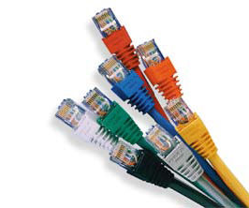
Dial-up Modem
Digital format
Analog format
central office
telephone
network
Internet
home
PC
home dial-up
modem
ISP modem
circuit switches
Uses existing telephony infrastructure
Home is connected to central office
up to 56Kbps direct access to router (slow)
Can’t surf and phone at same time: not “always on”
Notes:
twisted-pair wire

Slide 39
Access in the Enterprise and Home: Ethernet and WiFi
On corporate and university campus, and increasingly home settings, LAN is used to connect an end system to the edge router.
Although there are many types of LAN technologies, Ethernet is by far the most prevalent access technology in corporate, university, and home networks.

Slide 40
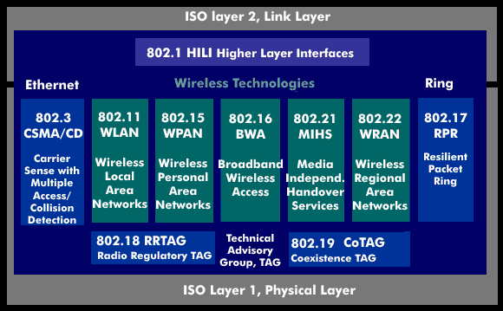
IEEE 802 Standards

Slide 41
Ethernet Internet access
100 Mbps
Institutional
router
Ethernet
switch
To Institution’s ISP
100 Mbps
1 Gbps
100 Mbps
server
Typically used in companies, universities, etc
10 Mbps, 100Mbps, 1Gbps, 10Gbps Ethernet
Today, end systems typically connect into Ethernet switch
Notes:
★☆

Slide 42
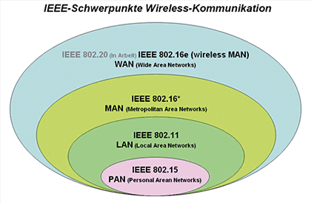
Wireless access networks
router
base
station
shared wireless access network connects end system to router
via base station, or “access point”
wireless LANs:
802.11b/g (WiFi): 100Mbps
wider-area wireless access
provided by telco operator
1/10/100 Mbps? over cellular system
WiMAX (IEEE 802.16)
LTE (Long Term Evolution)
mobile
hosts
Notes:
WiMAX 的全名是微波存取全球互通(Worldwide Interoperability for Microwave Access)

Slide 43
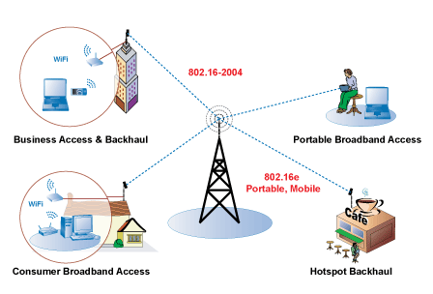

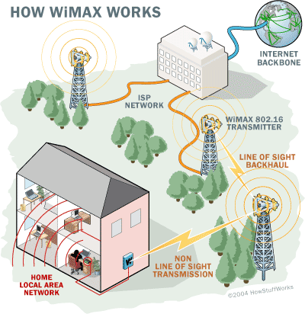
WiMAX:
Wireless Interoperability for Microwave Access
Making broadband available anywhere
Leads WiMAX being a Personal Broadband technology
Notes:
Fixed WiMAX is developed based on the IEEE 802.16-2004 standard and is optimized for fixed and nomadic applications in LOS and NLOS environments. Mobile WiMAX is based on the IEEE 802.16e standard and targeted primarily for portable and mobile applications in NLOS environment.

Slide 44
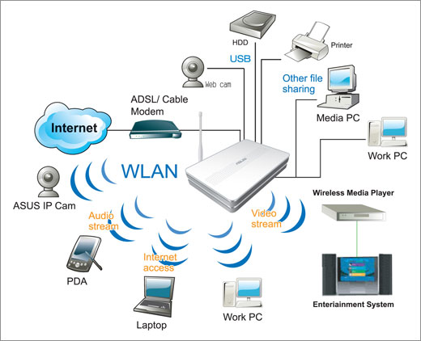
Home networks
Typical home network
components:
DSL or cable modem
router/firewall
Ethernet
wireless access point
wireless
laptops
to/from
cable
headend
cable
modem
Router
/firewall
wireless
access
point (WAP)
Ethernet

Slide 45
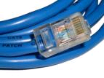
Physical Media
Twisted Pair (TP)
two insulated copper wires
Category 3: traditional phone wires, 10 Mbps Ethernet
Category 5: 100Mbps Ethernet
Bit: propagates between transmitter/rcvr pairs
physical link: what lies between transmitter & receiver
guided media:
signals propagate in solid media: copper, fiber, coax
unguided media:
signals propagate freely, e.g., radio

Slide 46


Physical Media: coax, fiber
Fiber optic cable:
glass fiber carrying light pulses, each pulse a bit
high-speed operation:
high-speed point-to-point transmission (e.g., 10’s-100’s Gbps)
low error rate: repeaters spaced far apart ; immune to electromagnetic noise
Coaxial cable:
two concentric copper conductors
bidirectional
baseband:
single channel on cable
legacy Ethernet
broadband:
multiple channels on cable
HFC
Notes:
The difference between baseband coaxial and broadband coaxial cable is:
baseband coaxial technology uses digital signaling in which the cable carries only one type of digital signal.
Where as the broadband coaxial technology typically transmits analog signals and is capable of transmitting multiple frequencies of data simultaneously.

Slide 47
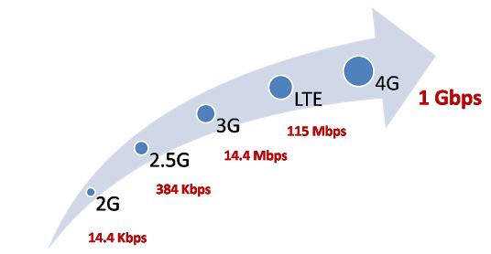
Physical media: radio
signal carried in electromagnetic spectrum
no physical “wire”
bidirectional
propagation environment effects:
reflection
obstruction by objects
interference
Radio link types:
Terrestrial microwave
e.g. up to 45 Mbps channels
LAN (e.g., Wifi)
11Mbps, 54 Mbps
wide-area (e.g., cellular)
3G cellular: ~ 3.84 Mbps
4G: ~ 100Mbps
satellite
Kbps to 45Mbps channel (or multiple smaller channels)
270 msec end-end delay
geosynchronous versus low altitude
Notes:
geosynchronous
英 [ˌdʒɪə'sɪŋkrənəs] 美 [ˌdʒɪr'sɪŋkrənəs]
adj.与地球的相对位置不变的；
Carriers that use orthogonal frequency-division multiplexing (OFDM) instead of time division multiple access (TDMA) or code division multiple access (CDMA) are increasingly marketing their services as being 4G, even when their data speeds are not as fast as the International Telecommunication Union (ITU) specifies. According to the ITU, a 4G network requires a mobile device to be able to exchange data at 100 Mbit/sec. A 3G network, on the other hand, can offer data speeds as slow as 3.84 Mbit/sec.
Two forms of 4G been developed and are in use: WiMAX and LTE (Long Term Evolution).
Although carriers still differ about whether to build 4G data networks using Long Term Evolution (LTE) or Worldwide Interoperability for Microwave Access WiMAX, all carriers seem to agree that OFDM is one of the chief indicators that a service can be legitimately marketed as being 4G.
OFDM is a type of digital modulation in which a signal is split into several narrowband channels at different frequencies. This is more efficient than TDMA, which divides channels into time slots and has multiple users take turns transmitting bursts or CDMA, which simultaneously transmits multiple signals on the same channel.
Wideband Code Division Multiple Access (WCDMA) was the first technical standard used for 3G. It's now more commonly known as Universal Mobile Telecommunications System (UMTS). More modern forms of 3G are High Speed Packet Access (HSPA) and HSPA+. The latter allows for faster speeds up to 42Mbps, twice that of HSPA.
4G's headline download speed is 100Mbps and a blistering 50Mbps for upload. This makes 4G is more than twice as fast as the latest 3G technology and many more times faster than previous versions.
Of course, these speeds are theoretical, and such speeds won't be reached in real-world use. However, that doesn't mean 4G isn't twice as quick. In our tests, which we'll get to later, we saw speeds around three times faster on 4G compared to 3G, and an even larger improvement with uploads.
For video streaming and similar tasks, where you would typically require Wi-Fi for smooth performance, 4G should allow you to have a 'home broadband' experience on the move. EE expects the average speed to be between 8- and 12Mbps, potentially faster than the 5.9Mbps average for ADSL home broadband. The speed differential should be akin to switching from 3G to Wi-Fi.
The main reason 4G is faster than 3G is because of Orthogonal Frequency-Division Multiplexing (OFDM).
It sounds complicated, but it's the same technology used in Wi-Fi, ADSL broadband, digital TV and radio.
OFDM is a technique for squeezing more data onto the same amount of radio frequency. It also reduces latency and interference. Data is split up and sent via small chunks of frequency in parallel, therefore increasing the capacity of the network.
Multiple-input and multiple-output, or MIMO, is another reason 4G is able to provide faster speeds. It is simply the use of multiple antenna arrays at both the transmitter and receiver to improve communication performance.
This allows more data to be transferred without requiring additional bandwidth or drawing more power. The most common configuration currently is a 2x2 MIMO, found in many smartphones and some tablets. A 4x4 setup is also possible and promises even faster speeds but is still a little way off making its way onto devices. Since different setups are possible, one phone could provide faster 4G speeds than another.
With 3G handsets, most of us take roaming for granted. We take our phones travelling around the world, and expect to be able to pick up emails and browse websites as soon as we land. Things are different with 4G.
Although there are 4G networks in many countries around the world, your UK 4G smartphone won't necessarily work wherever you go. The reason is that 4G doesn't operated on the same frequencies in every country.
Don't assume that if you have good 3G coverage now you will also get good 4G coverage when the new network launches in your area.
Currently, there are two technologies that have been submitted to the International Telecommunication Union (ITU) as viable 4G candidates: LTE Advanced, which was standardized by the 3GPP and 802.16m, standardized by the IEEE (also known as WinMAX).
New mobile generations have appeared about every ten years since the first move from 1981 analog (1G) to digital (2G) transmission in 1992. This was followed, in 2001, by 3G multi-media support, spread spectrum transmission and, at least, 200 kbit/s peak bit rate, in 2011/2012 to be followed by "real" 4G, which refers to all-Internet Protocol (IP) packet-switched networks giving mobile ultra-broadband (gigabit speed) access.
As opposed to earlier generations, a 4G system does not support traditional circuit-switched telephony service, but all-Internet Protocol (IP) based communication such as IP telephony.

Slide 48
Unit 1: roadmap
1.1 What is a network?
1.2 What is the Internet?
1.3 Network edge
end systems, access networks, links
1.4 Network core
circuit switching, packet switching, network structure
1.5 Delay, loss and throughput in packet-switched networks
1.6 Protocol layers, service models
1.7 Networks under attack: security
1.8 History

Slide 49
The Network Core
What is at the core of networks?
mesh of interconnected routers
Two fundamental approaches: how is data transferred through net?
packet-switching: data sent thru net in discrete “chunks”
circuit switching: dedicated circuit per call: telephone net
In the jargon of telephony, a connection is referred to a circuit
Reality: pure (a) / pure (b) / mixture (a) + (b)
Notes:
Although packet switching and circuit switching are both prevalent in today’s telecommunication networks, the trend has certainly been in the direction of packet switching.
Even many of today’s circuit-switched telephone networks are slowly migrating toward packet switching. In particular, telephone networks often use packet switching for the expensive overseas portion of a telephone call.

Slide 50
Network Core: Circuit Switching
End-end resources reserved for “call”
link bandwidth, switch capacity
dedicated resources: no sharing
circuit-like (guaranteed) performance: a constant rate such as 64kbps in telephone networks
In the exchange of the constant speed, call setup required

Slide 51
Network Core: Circuit Switching
How to carry some number of connections over one physical link? network resources (e.g., bandwidth) divided into “pieces”
pieces allocated to calls
resource piece idle if not used by owning call (no sharing)
Dividing link bandwidth into “pieces”
e.g., each link has n circuits
A link is considered to be a medium providing a range of frequencies over all times
A circuit in a link is implemented with either
Frequency-Division Multiplexing (FDM)
Time-Division Multiplexing (TDM)

Slide 52
Circuit Switching: FDM and TDM
A specific network link supports up to four circuits.
Example:
FDM
4 users
frequency
time
TDM
frequency
time

Slide 53
Numerical example
How long does it take to send a file of 640,000 bits from host A to host B over a circuit-switched network?
All links are 1.536 Mbps
Each link uses TDM with 24 slots/sec
500 msec to establish end-to-end circuit
Let’s work it out!
Each circuit has a transmission rate of 1536 kbps/24 = 64 kbps, so it takes (640,000 bits)/(64 kbps) = 10 sec to transmit the file. Total time: 10+0.5 = 10.5 sec.

Slide 54

Network Core: Packet Switching
each end-end data stream divided into packets
user A, B packets share network resources
each packet uses full link bandwidth
resources used as needed
resource contention:
aggregate resource demand can exceed amount available
no admission control: circuit switching only allows the number of connections it can afford
congestion: packets queue, wait for link use
store and forward: packets move one hop at a time
Node receives complete packet before forwarding
Bandwidth division into “pieces”
Dedicated allocation
Resource reservation

Slide 55
Packet Switching: Statistical Multiplexing
100 Mb/s
Ethernet
A
C
statistical multiplexing
1.5 Mb/s
B
queue of packets
waiting for output
link
D
E
Sequence of A & B packets does not have fixed pattern, bandwidth shared on demand ➔ statistical Time Division multiplexing vs synchronous TDM.
TDM: each host gets same slot in revolving TDM frame.

Slide 56
Packet Switching: store-and-forward
L
R
R
R
takes L/R seconds to transmit (push out) packet of L bits on to link at R bps
store and forward: entire packet must arrive at router before it can be transmitted on next link
delay = 3L/R (assuming zero propagation delay)
Example:
L = 7.5 Mbits
R = 1.5 Mbps
transmission delay =
3xL/R=15 sec
more on delay shortly …

Slide 57
Animation: Packet Switching
H₄
H₂
D
Router
B
H₆
Host
H₁
E
H₂ sends packets to H₆
A
H₁ sends packets to H₅
H₅
C
H₃
Internet

Slide 58
Packet switching versus circuit switching (1)
Packet switching allows more users to use network!
1 Mb/s link
each user:
100 kb/s when “active”
active 10% of time
circuit-switching:
10 users
packet switching:
with 35 users, probability > 10 active at same time is less than .0004
N users
1 Mbps link
Q: how did we get value 0.0004?

Slide 59
Packet switching versus circuit switching (2)
Is packet switching a “slam dunk winner?”
great for burst data
Greater efficiency in terms of resource sharing
simpler, no call setup
excessive congestion: packet delay and loss
protocols needed for reliable data transfer, congestion control
Q: How to provide circuit-like behavior?
bandwidth guarantees needed for audio/video apps
Virtual circuit network
Q: human analogies of reserved resources (circuit switching) versus on-demand allocation (packet-switching)?
Notes:
As a simple analogy, consider two restaurants, one that requires
reservations and another that neither requires reservations nor accepts them. For the
restaurant that requires reservations, we have to go through the hassle of calling
before we leave home. But when we arrive at the restaurant we can, in principle,
immediately communicate with the waiter and order our meal. For the restaurant
that does not require reservations, we don't need to bother to reserve a table. But
when we arrive at the restaurant, we may have to wait for a table before we can
communicate with the waiter.

Slide 60


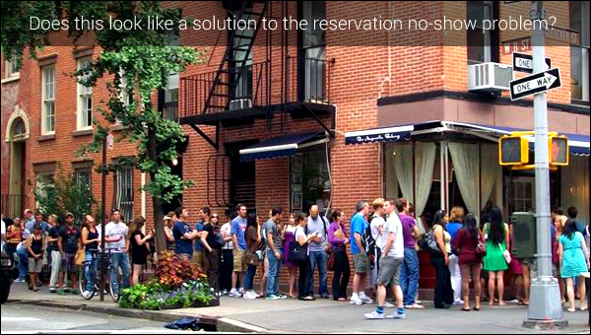
Restaurants with and without reservations
Popular no-booking restaurants

Slide 61
Virtual-Circuit Packet Switching
Hybrid of circuit switching and packet switching
Data is transmitted as packets
All packets from one packet stream are sent along a pre-established path (=virtual circuit)
Guarantees in-sequence delivery of packets
However: Packets from different virtual circuits may be interleaved
Example: ATM networks
Notes:
Other network architectures have defined and implemented service models that go beyond the Internet’s best-effort service.
For example, the ATM network architecture provides for guaranteed in-order delay, bounded delay, and guaranteed minimal bandwidth.
There have also been proposed service model extensions to the Internet architecture; for example, the IntServ architecture aims to provide end-to-end delay guarantees and congestion-free communication.
Interestingly, in spite of these well-developed alternatives, the Internet’s basic best-effort service model combined with adequate bandwidth provisioning have arguably proven to be more than “good enough” to enable an amazing range of applications, including streaming video services such as Netflix and voice-and-video-over-IP, real-time conferencing applications such as Skype and Facetime.

Slide 62
Timing in Circuit Switching
Host 1
Host 2
Node 1
Node 2
DATA
processing delay at Node 1
propagation delay
between Host 1
and Node 1
Circuit Establishment
propagation delay
between Host 2
and Host 1
Data Transmission
Circuit Termination

Slide 63
Comparison of Three Switching
Circuit Switching
telegraph
Packet Switching
P₁
M
P₂
P₁
Connection
setup
P₃
P₂
P₄
P₁
P₃
P₂
P₄
P₃
M
P₄
Data
sending
Message
Connection
release
M
t
A B C D
A B C D
A B C D
Features of
data sending
Store
and
forward
Store
and
Forward
Store
and
forward
Store
and
Forward

Slide 64
Timing of Virtual-Circuit Packet Switching
Host 1
Host 2
Node 1
Node 2
propagation delay
between Host 1
and Node 1
VC
establishment
Packet 1
Packet 2
Packet 1
Packet 3
Packet 2
Packet 3
Packet 1
Data
transfer
Packet 2
Packet 3
VC
termination

Slide 65
A Taxonomy of Communication networks
Communication networks can be classified based on the way in which the nodes exchange information:
Communication Network
Switched Communication Network
Broadcast Communication Network
Circuit-Switched Communication Network
Packet-Switched Communication Network
Datagram Network
Virtual Circuit Network

Slide 66

Internet structure: network structure 1
Network of networks: roughly (loosely) hierarchical
at center: “tier-1” ISPs (e.g., Level 3 Communications, AT&T, Sprint, and NTT), national/international coverage
treat each other as equals
Tier-1 providers interconnect (peer) privately
Tier 1 ISP
Tier 1 ISP
Tier 1 ISP
Interestingly, no group officially sanctions tier-1 status;
as the saying goes—if you have to ask if you’re a member of a group, you’re probably not.

Slide 67
Internet structure: network structure 2
“Tier-2” ISPs: smaller (often regional) ISPs
Connect to one or more tier-1 ISPs, possibly other tier-2 ISPs
Tier-2 ISPs also peer privately with each other.
Tier-2 ISP pays tier-1 ISP for connectivity to rest of Internet
Tier-2 ISP is customer of
tier-1 provider
Tier-2 ISP
Tier-2 ISP
Tier 1 ISP
Tier 1 ISP
Tier 1 ISP
Tier-2 ISP
Tier-2 ISP
Tier-2 ISP

Slide 68
Internet structure: network structure 3
“Tier-3” ISPs and local ISPs
last hop (“access”) network (closest to end systems)
local
ISP
Tier 3
ISP
local
ISP
local
ISP
local
ISP
Local and tier- 3 ISPs are customers of
higher tier ISPs
connecting them to rest of Internet
Tier-2 ISP
Tier-2 ISP
Tier 1 ISP
Tier 1 ISP
Tier 1 ISP
Tier-2 ISP
Tier-2 ISP
Tier-2 ISP
local
ISP
local
ISP
local
ISP
local
ISP

Slide 69
Internet structure: network structure 4
Network Structure 4 : the ecosystem—consisting of access ISPs, regional ISPs, tier-1 ISPs,
PoPs (points of presence),
multi-homing,
peering,
IXPs (Internet exchange points)
Which more closely resembles today’s Internet
Notes:
Internet exchange points (IXPs)
points of presence (PoPs),

Slide 70
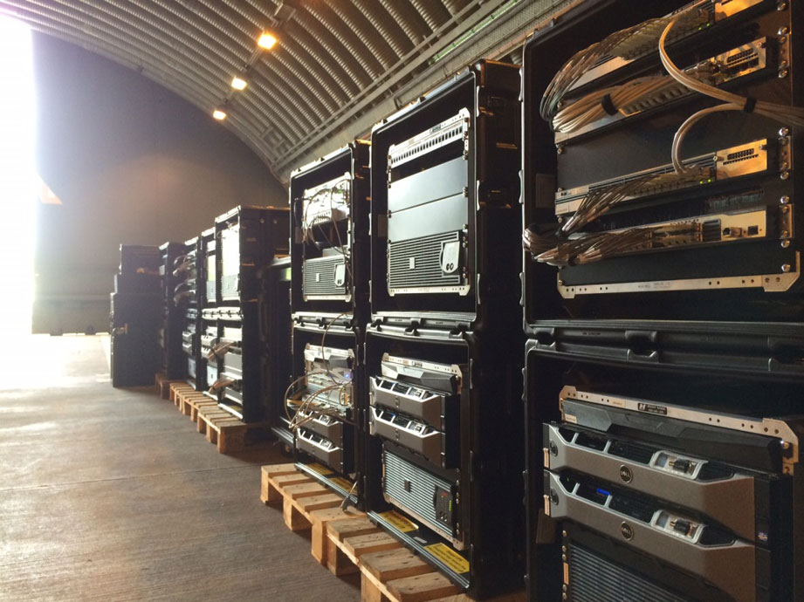
Explanation of some terms -- PoPs
A PoP is simply a group of one or more routers (at the same location) in the provider’s network where customer ISPs can connect into the provider ISP.
PoPs exist in all levels of the hierarchy, except for the bottom (access ISP) level.
For a customer network to connect to a provider’s PoP, it can lease a high-speed link from a third-party telecommunications provider to directly connect one of its routers to a router at the PoP.

Slide 71
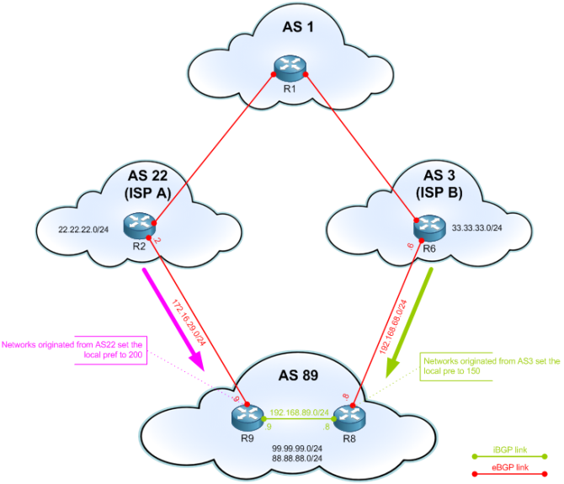
Explanation of some terms -- Multi-homing
Any ISP (except for tier-1 ISPs) may choose to multi-home, that is, to connect to two or more provider ISPs.
For example, an access ISP may multi-home with two regional ISPs
or it may multi-home with two regional ISPs and also with a tier-1 ISP.
Similarly, a regional ISP may multi-home with multiple tier-1 ISPs.

Slide 72

Explanation of some terms -- Peer
When two ISPs peer, it is typically settlement-free, that is, neither ISP pays the other.
tier-1 ISPs also peer with one another, settlement-free.
Normally customer ISPs pay their provider ISPs to obtain global Internet interconnectivity.
To reduce these costs, a pair of nearby ISPs at the same level of the hierarchy can peer.

Slide 73
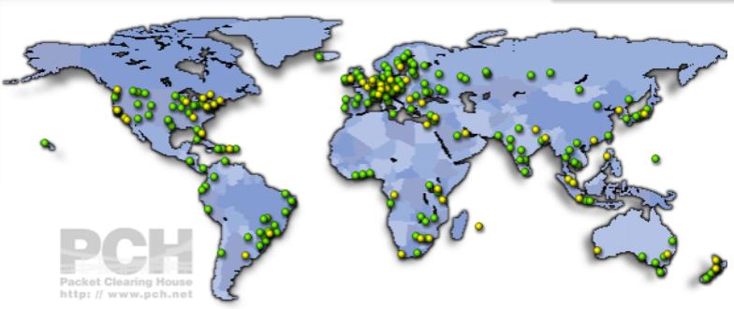
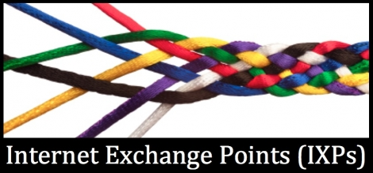
Explanation of some terms -- IXP
A third-party company can create an Internet Exchange Point (IXP)
typically in a stand-alone building with its own switches,
a meeting point where multiple ISPs can peer together.
There are roughly 450 IXPs in the Internet today
https://prefix.pch.net/applications/ixpdir/summary/

Slide 74
Explanation of some terms -- IXP
A third-party company can create an Internet Exchange Point (IXP)
typically in a stand-alone building with its own switches,
a meeting point where multiple ISPs can peer together.
There are 526 IXPs in the Internet today
https://www.pch.net/ixp/summary

Slide 75
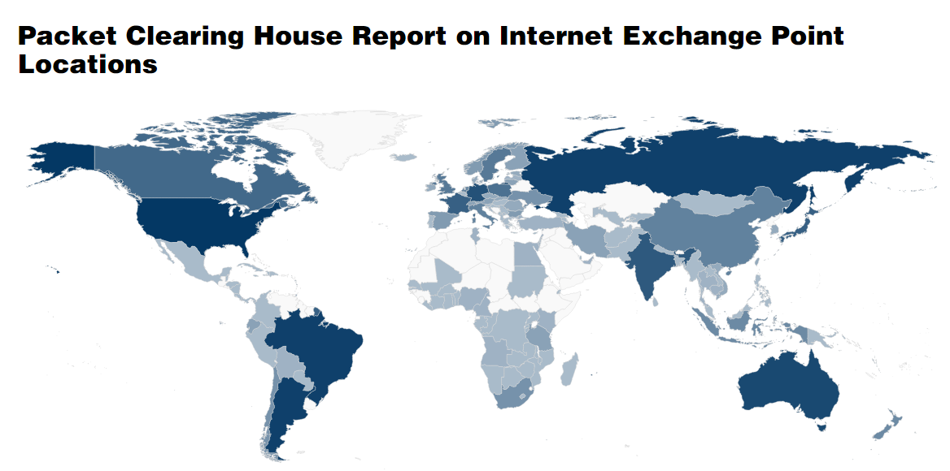
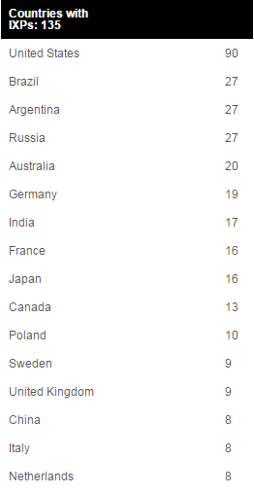
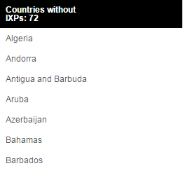
Last updated: Thu, 13 Sep 2018 02:55:06 +0000
This map plots the density distribution of the IXPs which form the core of the global Internet, by country.
Notes:
https://www.pch.net/ixp/summary
Packet Clearing House, Internet exchange point directory reports. Retrieved on Thursday 19th of September from http://www.pch.net/ixpdir/summary

Slide 76
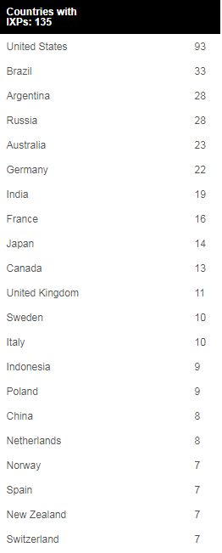
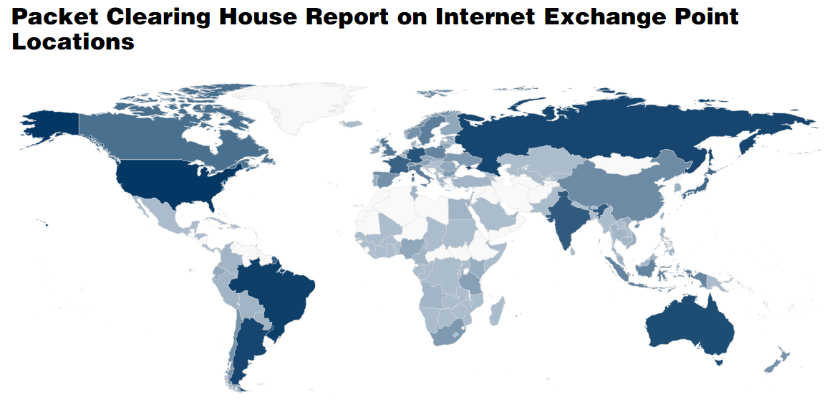
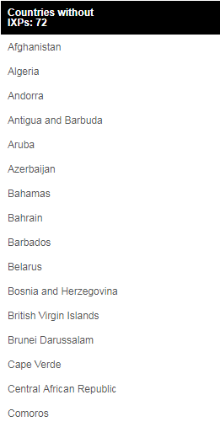
Last updated: Thu, 19 Sep 2019 12:07:24 +0000
This map plots the density distribution of the Internet Exchange Points (IXPs) which form the core of the global Internet, by country.

Slide 77
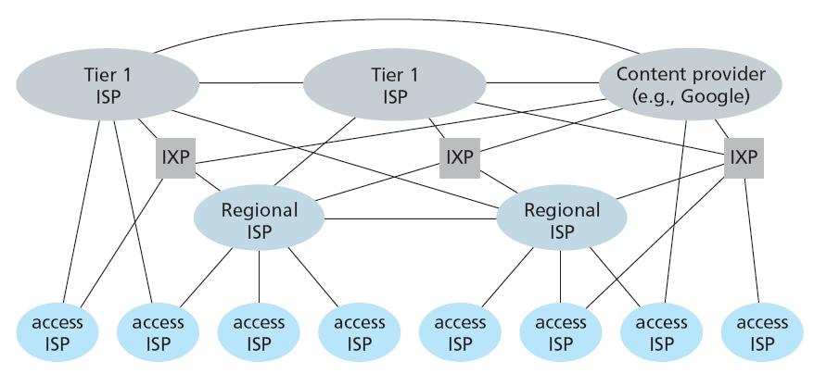
Internet structure: network structure 5
Builds on top of Network Structure 4 by adding content provider networks (Google is currently one of the leading examples)
Major content providers have created their own networks and connect directly into lower-tier ISPs where possible.
Notes:
Network Structure 5, illustrated in Figure 1.15, builds on top of Network
Structure 4 by adding content provider networks.

Slide 78
Internet structure: Summary
Today’s Internet—a network of networks—is complex:
consisting of a dozen or so tier-1 ISPs and hundreds of thousands of lower-tier ISPs.
The ISPs are diverse in their coverage, with some spanning multiple continents and oceans, and others limited to narrow geographic regions.
The lower-tier ISPs connect to the higher-tier ISPs, and the higher-tier ISPs interconnect with one another.
Users and content providers are customers of lower-tier ISPs, and lower-tier ISPs are customers of higher-tier ISPs.
In recent years, major content providers have also created their own networks and connect directly into lower-tier ISPs where possible.

Slide 79
Internet structure: network of networks
a packet passes through many networks!
local
ISP
Tier 3
ISP
local
ISP
local
ISP
local
ISP
Tier-2 ISP
Tier-2 ISP
Tier 1 ISP
Tier 1 ISP
Tier 1 ISP
Tier-2 ISP
Tier-2 ISP
Tier-2 ISP
local
ISP
local
ISP
local
ISP
local
ISP

Slide 80
Local ISP
Tier 3
Local ISP
Local ISP
Tier 2
Tier 2 ISP
Local ISP
Tier 1
Big
company
Local ISP
Big
company
Local ISP
Tier 1 ISP
Tier 1 ISP
Tier 2 ISP
Local ISP
Local ISP
Tier 2 ISP
NAP
一级 ISP
NAP
一级 ISP
Tier 1 ISP
Tier 2 ISP
Local ISP
Local ISP
Tier 2 ISP
Tier 2 ISP
Big
company
Local ISP
Local ISP
Local ISP
Local ISP
Company
A
B
Campus
Network
Campus
Network
Campus
Network
Campus
Network
Computer A → Local ISP → Tier 2 ISP → NAP → Tier 1 ISP → NAP → Tier 2 ISP → Local ISP → ComputerB
NAP: Network Access Point

Slide 81
Unit 1: roadmap
1.1 What is a network?
1.2 What is the Internet?
1.3 Network edge
end systems, access networks, links
1.4 Network core
circuit switching, packet switching, network structure
1.5 Delay, loss and throughput in packet-switched networks
How long does a packet take to pass through a router?
1.6 Protocol layers, service models
1.7 Networks under attack: security
1.8 History

Slide 82
How do loss and delay occur?
packets queue in router buffers
packet arrival rate to link exceeds output link capacity
packets queue, wait for turn
packet being transmitted (delay)
A
B
packets queueing (delay)
free (available) buffers: arriving packets
dropped (loss) if no free buffers

Slide 83
Four sources of packet delay
1. nodal processing:
check bit errors
determine output link
2. queuing
time waiting at output link for transmission
depends on congestion level of router
happens mainly in statistical multiplexing, namely packet-switched networks
Transmission (μs →ms)
A
Propagation
(ms)
B
nodal
Processing
(μs)
Queuing (μs →ms)

Slide 84
Delay in packet-switched networks
3. Transmission delay (a.k.a., store-and-forward delay):
R=link bandwidth (bps)
L=packet length (bits)
time to send bits into link = L/R
Time to convert data into signals
4. Propagation delay:
d = length of physical link
s = propagation speed in medium (~2x10⁸ m/sec)
propagation delay = d/s
Note: s and R are very different quantities!
transmission
A
propagation
B
nodal
processing
queuing
Notes:
2x10^8 - 3x10^8 meters/sec

Slide 85
Nodal delay
d_{proc} = processing delay
typically a few microsecs or less
d_{queue} = queuing delay
depends on congestion
d_{trans} = transmission delay
= L/R, significant for low-speed links
d_{prop} = propagation delay
a few microsecs to hundreds of msecs

Slide 86
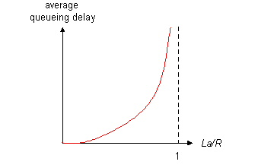
Queuing delay (revisit)
R=link bandwidth (bps)
L=packet length (bits)
a=average packet arrival rate
traffic intensity = La/R
A ratio of the average arrival rate to the average departure rate
La/R ~ 0: average queueing delay small
La/R -> 1: delays become large
La/R > 1: more “work” arriving than can be serviced, average delay infinite!

Slide 87
Packet loss
queue (i.e., buffer) preceding link in buffer has finite capacity
packet arriving to full queue dropped (i.e., lost)
lost packet may be retransmitted by previous node, by source end system, or not at all
performance at a node is often measured not only in terms of delay, but also in terms of the probability of packet loss.
buffer
(waiting area)
packet being transmitted
A
B
packet arriving to
full buffer is lost

Slide 88
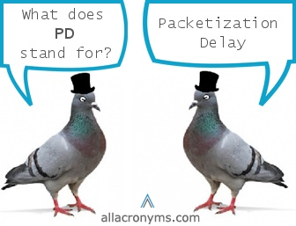
End System, Application, and Other Delays
Additional significant delays in the end systems
Example 1: an end system wanting to transmit a packet into a shared medium may purposefully delay its transmission as part of its protocol.
Example 2: media packetization delay: present in Voice over-IP (VoIP) applications.
Notes:
For example, an end system wanting to transmit a packet into a shared medium (e.g., as in a WiFi or cable modem scenario)
may purposefully delay its transmission as part of its protocol for sharing the
medium with other end systems; we’ll consider such protocols in detail in Chapter
5.

Slide 89
Throughput
throughput: rate (bits/time unit) at which bits transferred between sender/receiver
instantaneous: rate at given point in time
average: rate over longer period of time
link capacity
R_{s} bits/sec
link capacity
R_{c} bits/sec
server, with
file of F bits
to send to client
pipe that can carry
fluid at rate
R_{s} bits/sec
pipe that can carry
fluid at rate
R_{c} bits/sec
server sends bits
(fluid) into pipe

Slide 90
Throughput (more)
R_{s} < R_{c} What is average end-end throughput?
R_{s} bits/sec
R_{c} bits/sec
R_{s} > R_{c} What is average end-end throughput?
R_{s} bits/sec
R_{c} bits/sec
bottleneck link
link on end-end path that constrains end-end throughput

Slide 91
Throughput: Internet scenario
per-connection end-end throughput: min(R_{c},R_{s},R/10)
in practice: R_{c} or R_{s} is often bottleneck since the backbone links tend to be quite faster than links in the access networks
R_{s}
R_{s}
R_{s}
R
R_{c}
R_{c}
R_{c}
10 connections (fairly) share backbone bottleneck link R bits/sec

Slide 92
Unit 1: roadmap
1.1 What is a network?
1.2 What is the Internet?
1.3 Network edge
end systems, access networks, links
1.4 Network core
circuit switching, packet switching, network structure
1.5 Delay, loss and throughput in packet-switched networks
1.6 Protocol layers, service models
How is the Internet organized?
1.7 Networks under attack: security
1.8 History

Slide 93
Protocol “Layers”
Networks are complex!
many “pieces”:
hosts
routers
links of various media
applications
protocols
hardware, software
Question:
Is there any hope of organizing structure of network?
Or at least our discussion of networks?

Slide 94
Organization of air travel
ticket (purchase)
baggage (check)
gates (load)
runway takeoff
airplane routing
ticket (complain)
baggage (claim)
gates (unload)
runway landing
airplane routing
airplane routing
a series of steps

Slide 95
Layering of airline functionality
ticket (purchase)
baggage (check)
gates (load)
runway (takeoff)
airplane routing
ticket (complain)
baggage (claim
gates (unload)
runway (land)
airplane routing
ticket
baggage
gate
takeoff/landing
airplane routing
airplane routing
airplane routing
departure
airport
intermediate air-traffic
control centers
arrival
airport
Layers: each layer implements a service
via its own internal-layer actions
relying on services provided by layer below

Slide 96
Why layering?
Dealing with complex systems:
explicit structure allows identification, relationship of complex system’s pieces
layered reference model for discussion
modularization eases maintenance, updating of system
change of implementation of layer’s service transparent to rest of system
e.g., change in gate procedure doesn’t affect rest of system
layering considered harmful?
Functionality may be duplicated.
One layer may need information present only in another layer (violates the goal of separation of layers)

Slide 97
Internet protocol stack
application: supporting network applications
FTP, SMTP, HTTP
transport: process-process data transfer
TCP, UDP
network: routing of datagrams from source to destination
IP, routing protocols
link: data transfer between neighboring network elements
PPP, Ethernet
physical: bits “on the wire”
application
transport
network
link
physical

Slide 98
OSI reference model
presentation: allow applications to interpret meaning of data, e.g., encryption, compression, machine-specific conventions
session: synchronization, checkpointing, recovery of data exchange
Internet stack “missing” these layers!
these services, if needed, must be implemented in application
needed?
application
presentation
session
transport
network
link
physical

Slide 99
Encapsulation
source
message
M
application
transport
network
link
physical
segment
H_{t}
M
H_{t}
datagram
H_{n}
H_{t}
M
frame
H_{l}
H_{n}
H_{t}
M
T_{l}
link
physical
switch
destination
H_{n}
H_{t}
M
network
link
physical
M
application
transport
network
link
physical
H_{l}
H_{n}
H_{t}
M
H_{n}
H_{t}
M
H_{t}
M
H_{n}
H_{t}
M
H_{l}
H_{n}
H_{t}
M
router
T_{l}

Slide 100
TCP/IP Model or Internet Protocol Suite
TCP/IP protocols can serve different applications, so called “everything over IP”
TCP/IP protocols allow IP protocol runs on different networks, i.e., “IP over everything”.
application
transport
Internet/
network
Host to
network
HTTP
…
SMTP
DNS
…
RTP
TCP
UDP
like a sandglass.
IP
Network
Interface 1
Network
Interface 2
…
Network
Interface 3

Slide 101
Unit 1: roadmap
1.1 What is a network?
1.2 What is the Internet?
1.3 Network edge
end systems, access networks, links
1.4 Network core
circuit switching, packet switching, network structure
1.5 Delay, loss and throughput in packet-switched networks
1.6 Protocol layers, service models
1.7 Networks under attack: security
1.8 History

Slide 102
Network Security
The field of network security is about:
how bad guys can attack computer networks
how we can defend networks against attacks
how to design architectures that are immune to attacks
Internet not originally designed with (much) security in mind
original vision: “a group of mutually trusting users attached to a transparent network” ☺
Internet protocol designers playing “catch-up”
security considerations in all layers!
Notes:
catchup
英 ['kætʃəp] 美 ['kætʃəp]
n.调味酱（如蕃茄酱之类）；
catch-up
释义（向别人水平的）追赶；
catch-up 加紧弥补

Slide 103
Bad guys can put malware into hosts via Internet (1)
Malware can get in host from a virus, worm, or trojan horse.
Spyware malware can record keystrokes, web sites visited, upload info to collection site.
Infected host can be enrolled in a botnet, used for spam and distributed denial of service (DDoS) attacks.
A bot is a computer program that carries out tasks for other programs, especially on the Internet
Botnet is a jargon term for a collection of software agents or robots, The term is most commonly associated with malicious software
Malware is often self-replicating: from an infected host, seeks entry into other hosts
Notes:
Trojan
英 [ˈtrəʊdʒən] 美 [ˈtroʊdʒən]
n.特洛伊；

Slide 104
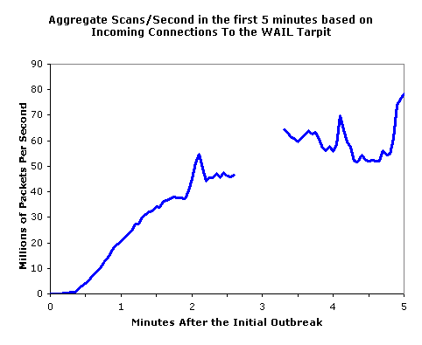
Bad guys can put malware into hosts via Internet (2)
Worm:
Malware that can enter a device without any explicit user interaction
infection by passively receiving object that gets itself executed
self- replicating: propagates to other hosts, users
Trojan horse
Hidden part of some otherwise useful software
Non-replicating malware that appears to perform a desirable function but instead facilitates unauthorized access
Today often on a Web page (Active-X, plugin)
Virus
Malware that requires some form of user interaction
infection by receiving object (e.g., e-mail attachment), actively executing
self-replicating: propagate itself to other hosts, users
Sapphire Worm: aggregate scans/sec
in first 5 minutes of outbreak (CAIDA, UWisc data)

Slide 105
Bad guys can attack servers and network infrastructure
Denial of service (DoS): attackers make resources (server, bandwidth) unavailable to legitimate traffic by overwhelming resource with bogus traffic
select target
break into hosts around the network (see botnet)
send packets toward target from compromised hosts
target
Notes:
As the name suggests, a DoS attack renders a network, host, or other piece
of infrastructure unusable by legitimate users.

Slide 106
Three Categories of DoS Attacks
Vulnerability attack
Bandwidth flooding
Connection flooding

Slide 107
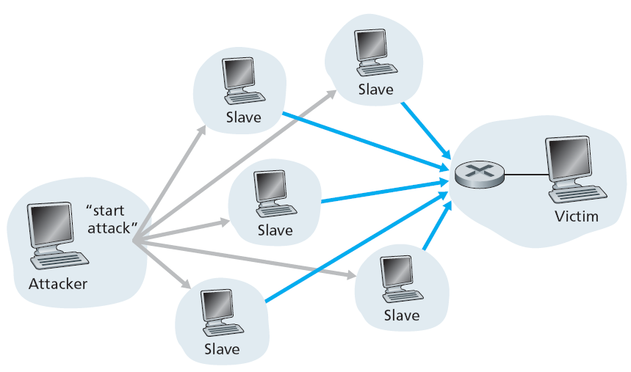
Distributed Denial of Services (DDoS)
DDoS attacks leveraging botnets with thousands of comprised hosts are a common occurrence today
Q: DDos attacks are much harder to detect and defend against than a DoS attack from a single host. Why?

Slide 108
The bad guys can sniff packets
Packet sniffing:
broadcast media (shared Ethernet, wireless)
promiscuous network interface reads/records all packets (e.g., including passwords!) passing by
A
C
src:B dest:A payload
B
Wireshark software used for our labs is a (free) packet-sniffer

Slide 109
The bad guys can use false source addresses
A way to masquerade as someone you trust
IP spoofing: send packet with false source address
A
C
src:B dest:A payload
B

Slide 110
The bad guys can record and playback
record-and-playback: sniff sensitive info (e.g., password), and use later
password holderis that user from system point of view
C
A
src:B dest:A user: B; password: foo
B

Slide 111
Unit 1: roadmap
1.1 What is a network?
1.2 What is the Internet?
1.3 Network edge
end systems, access networks, links
1.4 Network core
circuit switching, packet switching, network structure
1.5 Delay, loss and throughput in packet-switched networks
1.6 Protocol layers, service models
1.7 Networks under attack: security
1.8 History

Slide 112
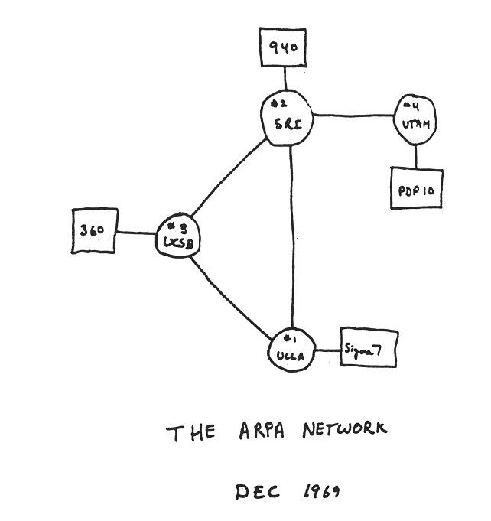
Internet History (1)
1961-1972: Early packet-switching principles
1961: Kleinrock - queueing theory shows effectiveness of packet-switching
1964: Baran - packet-switching in military nets
1967: ARPAnet conceived by Advanced Research Project Agency
1969: first ARPAnet node operational
1972:
ARPAnet public demonstration
NCP (Network Control Protocol) first host-host protocol
first e-mail program
ARPAnet has 15 nodes

Slide 113
Internet History (2)
1972-1980: Internetworking, new and proprietary nets
1970: ALOHAnet satellite network in Hawaii
1974: Cerf and Kahn - architecture for interconnecting networks
1976: Ethernet at Xerox PARC
late70’s: proprietary architectures: DECnet, SNA, XNA
late 70’s: switching fixed length packets (ATM precursor)
1979: ARPAnet has 200 nodes
Cerf and Kahn’s internetworking principles:
minimalism, autonomy - no internal changes required to interconnect networks
best effort service model
stateless routers
decentralized control
define today’s Internet architecture

Slide 114
Internet History (3)
1980-1990: new protocols, a proliferation of networks
1983: deployment of TCP/IP
1982: smtp e-mail protocol defined
1983: DNS defined for name-to-IP-address translation
1985: ftp protocol defined
1988: TCP congestion control
new national networks: Csnet, BITnet, NSFnet, Minitel
100,000 hosts connected to confederation of networks
1989-1991: Web was invented at CERN

Slide 115
Internet History (4)
1990, 2000’s: commercialization, the Web, new apps
Early 1990’s: ARPAnet decommissioned
1991: NSF lifts restrictions on commercial use of NSFnet (decommissioned, 1995)
early 1990s: WWW
hypertext [Bush 1945, Nelson 1960’s]
HTML, HTTP: Berners-Lee
1994: Mosaic, later Netscape
late 1990’s: commercialization of the Web
Late 1990’s – 2000’s:
more killer apps: instant messaging, P2P file sharing
network security to forefront
est. 50 million host, 100 million+ users
backbone links running at Gbps

Slide 116
Internet History (5)
The New Millennium:
Aggressive deployment of broadband Internet access to homes has set the stage for a wealth of video applications (e.g., YouTube, Netflix, Skype)
WiFi networks and medium-speed (up to a few Mbps) Internet access via 3G and 4G cellular telephony networks
rapid emergence of hand-held computers (iPhones, Androids, iPads, and so on)
Online social networks (e.g., Facebook and QQ) have created massive people networks on top of the Internet.
Online service providers, such as Google and Microsoft, have deployed their own extensive private networks
Clouds …

Slide 117
Introduction: Summary
Covered a “ton” of material!
Internet overview
what’s a protocol?
network edge, core, access network
packet-switching versus circuit-switching
Internet structure
performance: loss, delay, throughput
layering, service models
security
history
You now have:
context, overview, “feel” of networking
more depth, detail to follow!

Slide 118
Summary: Internet Architecture
packet-switched datagram network
IP is the glue (network layer overlay)
IP hourglass architecture
all hosts and routers run IP
stateless architecture
no per flow state inside network
TCP
UDP
IP
Satellite
Ethernet
ATM
IP hourglass

Slide 119
Summary: Minimalist Approach
Dumb network
IP provide minimal functionalities to support connectivity
addressing, forwarding, routing
Smart end system
transport layer or application performs more sophisticated functionalities
flow control, error control, congestion control
Advantages
accommodate heterogeneous technologies (Ethernet, modem, satellite, wireless)
support diverse applications (telnet, ftp, Web, X windows)
decentralized network administration

Slide 120
Homework for all
Packet switching allows more users to use network!
1 Mb/s link
each user:
100 kb/s when “active”
active 10% of time
circuit-switching:
10 users
packet switching:
with 35 users, probability > 10 active at same time is less than .0004
N users
1 Mbps link
Q: how did we get value 0.0004?

Slide 121
Homework
List the available residential access technologies in your city. For each type of access, provide the advertised downstream rate, upstream rate, and monthly price.
Describe the most popular wireless Internet access technologies today. Compare and contrast them.
Why will two ISPs at the same level of the hierarchy often peer with each other? How does an IXP earn money?
Some content providers have created their own networks. Describe Google’s network. What motivates content providers to create these networks?

Slide 122
Optional Homework
DDos attacks are much harder to detect and defend against than a DoS attack from a single host.
Why? Give your explanation in 5 slides.
Internet applications run on end systems. Do you think they run also in the packet switches in the network core?

Slide 123
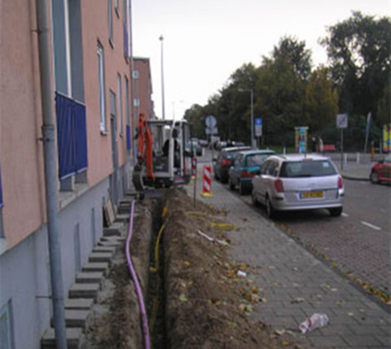
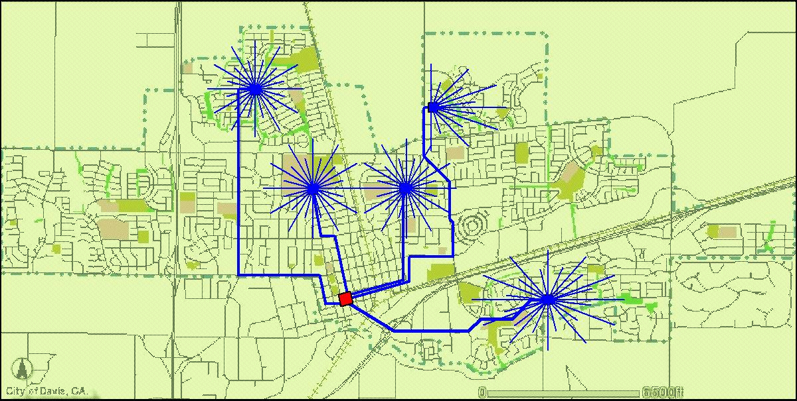
Homework (1)
Investigate the status quo of FTTx deployment.
E.g., statistical data in the world or in China.

Slide 124
Homework (2)
Investigate the status quo of residential access network (dial-up modem, DSL, HFC, Fiber optics) in China or any other countries in the world.

Slide 125
Homework (3)
Give a brief introduction about an internet appliance which you feel interested in.

Slide 126
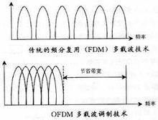
Homework (5)
Understand the principles of OFDM.

Slide 127
Homework (2)
Make PPT (at most 5 slides) to introduce and compare the characteristics of
hubs, switches, bridges and routers.

